Slide 1
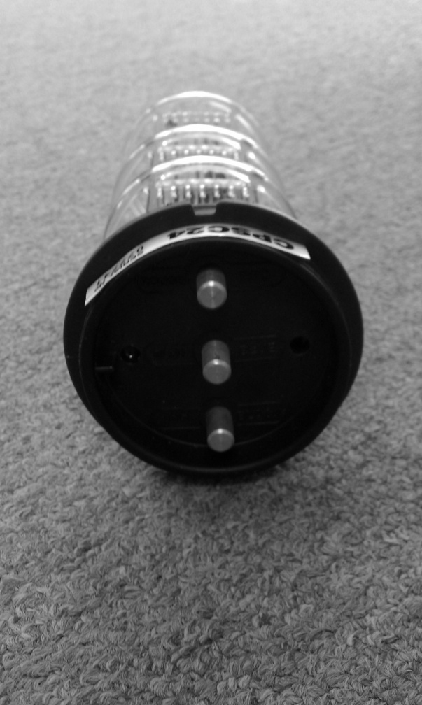
New Cell Cord Connections
Please note that you have been provided with a new Cell Cord that has three separate connections rather than one cell plug.
The connectors must be connected as follows:
Starting at the top of the cell (cell head notch on top) place the red connector on the top terminal bolt. Place the blue connector on the middle terminal bolt and place the black connector on the bottom terminal bolt.
Notch
Red
Blue
Black

